Slide 1

INSTITUTE - UIE
DEPARTMENT- ACADEMIC UNIT-2
Bachelor of Engineering (Computer Science & Engineering)
Subject Name: Object Oriented Programming using C++
Code:20CST151
Unit-1
Topic: Friend Function
DISCOVER . LEARN . EMPOWER

Slide 2


Object Oriented Programming using C++
Course Objectives
To enable the students to understand various stages and constructs of C++ programming language and relate them to engineering programming problems.
To improve their ability to analyze and address variety of problems in programming domains.

Slide 3



Course Outcomes
CO Number | Title | Level
CO1 | Provide the environment that allows students to understand object-oriented programming Concepts. | Understand
CO2 | Demonstrate basic experimental skills for differentiating between object-oriented and procedural programming paradigms and the advantages of object-oriented programs. | Remember
CO3 | Demonstrate their coding skill on complex programming concepts and use it for generating solutions for engineering and mathematical problems. | Understand
CO4 | Develop skills to understand the application of classes, objects, constructors, destructors, inheritance, operator overloading and polymorphism, pointers, virtual functions, exception handling, file operations and handling. | Understand

Slide 4
Scheme of Evaluation
Sr. No. | Type of Assessment Task | Weightage of actual conduct | Frequency of Task | Final Weightage in Internal Assessment (Prorated Marks) | Remarks
1. | Assignment* | 10 marks of each assignment | One Per Unit | 10 marks | As applicable to course types depicted above.
2. | Time Bound Surprise Test | 12 marks for each test | One per Unit | 4 marks | As applicable to course types depicted above.
3. | Quiz | 4 marks of each quiz | 2 per Unit | 4marks | As applicable to course types depicted above.
4. | Mid-Semester Test** | 20 marks for one MST. | 2 per semester | 20 marks | As applicable to course types depicted above.
5. | Presentation*** |  |  | Non Graded: Engagement Task | Only for Self Study MNGCourses.
6. | Homework | NA | One per lecture topic (of 2 questions) | Non-Graded: Engagement Task | As applicable to course types depicted above.
7. | Discussion Forum | NA | One per Chapter | Non Graded: Engagement Task | As applicable to course types depicted above.
8. | Attendance and Engagement Score on BB | NA | NA | 2 marks

Slide 5
CONTENTS
Concept of Friend Function
Characteristics of friend Function
Examples to Understand the concept of Friend Function
Notes:
Computer in the diagram is 3rd generation computer. The period of third generation was from 1965-1971. The computers of third generation used Integrated Circuits (ICs) in place of transistors. A single IC has many transistors, resistors, and capacitors along with the associated circuitry. The main features of third generation are −
IC used
More reliable in comparison to previous two generations
Smaller size
Generated less heat
Faster
Lesser maintenance
Costly
AC required
Consumed lesser electricity
Supported high-level language

Slide 6
Friend Function
If a function is defined as a friend function in C++, then the protected and private data of a class can be accessed using the function.
By using the keyword friend compiler knows the given function is a friend function.
For accessing the data, the declaration of a friend function should be done inside the body of a class starting with the keyword friend.

Slide 7
Friend Function
Declaration of friend function in C++
class class_name
{
friend data_type function_name(argument/s); // syntax of friend function.
};
In the above declaration, the friend function is preceded by the keyword friend. The function can be defined anywhere in the program like a normal C++ function. The function definition does not use either the keyword friend or scope resolution operator.

Slide 8
Characteristics of a Friend function
•The function is not in the scope of the class to which it has been declared as a friend.
•It cannot be called using the object as it is not in the scope of that class.
•It can be invoked like a normal function without using the object.
•It cannot access the member names directly and has to use an object name and dot membership operator with the member name.
•It can be declared either in the private or the public part.

Slide 9
Example
#include <iostream>
using namespace std;
class Temperature
{
int celsius;
public:
Temperature()
{
celsius = 0;
}
friend int temp( Temperature ); // declaring friend function
};

Slide 10
Example Contd…
int temp( Temperature t ) // friend function definition
{
t.celsius = 40;
return t.celsius;
}
int main()
{
Temperature tm;
cout << "Temperature in celsius : " << temp( tm ) << endl;
return 0;
}

Slide 11
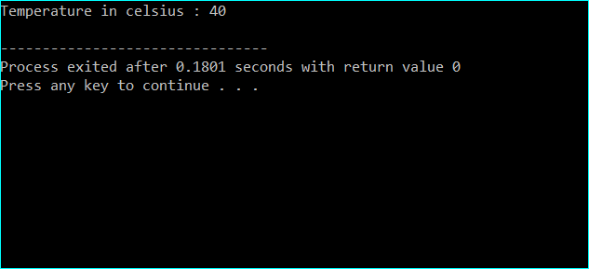
OUTPUT

Slide 12
Example: Addition of two numbers using friend function
#include<iostream.h>
#include<conio.h>
using namespace std;
class temp
{
int a, b, add;
public:
void input()
{
cout << "Enter the value of x and y:";
cin >> x>>y;
}

Slide 13
Example Contd…
friend void add(temp &t);
void display()
{
cout << "The sum is :" << z;
}
};
void add(temp &t)
{
t.add = t.a + t.b;
}

Slide 14
Example Contd…
int main()
{
temp t1;
t1.input();
add(t1);
t1.display();
return 0;
}

Slide 15

Output

Slide 16
Example: Program to add two complex numbers using friend function
#include<iostream>
using namespace std;
class complex
{ int real,imag;
public:
void set()
{cout<<"enter real and imag part";
cin>>real>>imag;
}
friend complex sum(complex,complex);
void display(); };

Slide 17
Example Contd…
void complex::display()
{
cout<<"the sum of complex num is"<<real<<"+i"<<imag;
}
complex sum(complex a,complex b)
{
complex t;
t.real=a.real+b.real;
t.imag=a.imag+b.imag;
return t;
}

Slide 18
Example Contd…
int main()
{
complex a,b,c;
a.set();
b.set();
c=sum(a,b);
c.display();
return(0);
}

Slide 19

Output

Slide 20
Summary
In this lecture we have discussed about Friend Function
We have discussed the characteristics of friend function
Discussed about examples of Friend Function

Slide 21
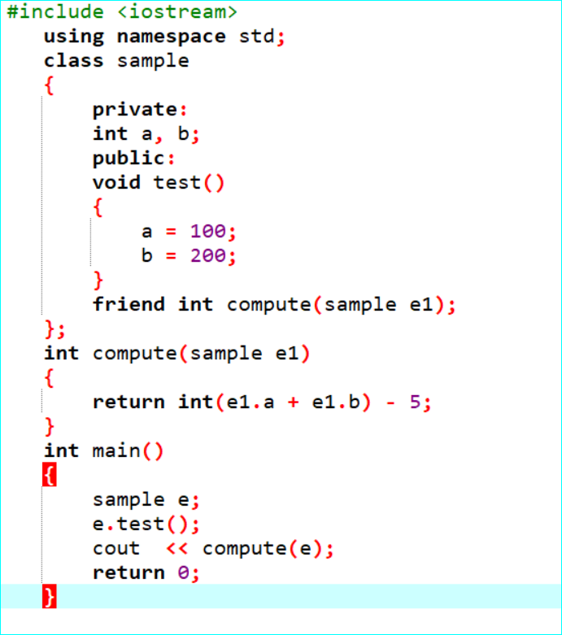
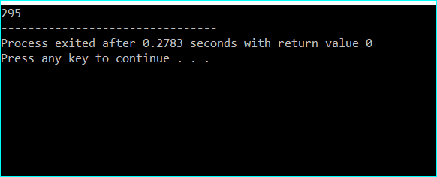
Frequently Asked question
Q1. What will be the output of the following C++ code?

Slide 22
Q2 What are the characteristics of friend functions?
Answer: A friend function is not in the scope of the class, in which it has been declared as friend.
It cannot be called using the object of that class.
It can be invoked like a normal function without any object.
Unlike member functions, it cannot use the member names directly.
It can be declared in public or private part without affecting its meaning.

Slide 23
Q3 Guideline that should be followed while using friend function?
Answer: When the application is needed to access a private member of another class, the only way is to utilize the friend functions.
The following are the guidelines to handle friend functions :
1. Declare the function with the keyword ‘friend’ that is followed by return type and followed by the function name.
2. Specify the class whose private members are to be accessed in the friend function within parenthesis of the friend function.
3. Write the code of the friend function in the class.
- The following code snippet illustrates the use of friend function :
friend void display(car); //Friend of the class 'car'
void display(car myCar)
{
cout<<"\nThe color of my car is : "<<myCar.color;
cout<<"\nThe speed of my car is : "<<myCar.speed;
}

Slide 24
Assessment Questions:
Q1:Pick out the correct statement.
a) A friend function may be a member of another class
b) A friend function may not be a member of another class
c) A friend function may or may not be a member of another class
d) None of the mentioned
2. Where does keyword ‘friend’ should be placed?
a) function declaration
b) function definition
c) main function
d) block function

Slide 25
3 . What is the syntax of friend function?
a) friend class1 Class2;
b) friend class;
c) friend class
d) friend class()
4. Which rule will not affect the friend function?
a) private and protected members of a class cannot be accessed from outside
b) private and protected member can be accessed anywhere
c) protected member can be accessed anywhere
d) private member can be accessed anywhere
5. What is a friend function in C++?
a) A function which can access all the private, protected and public members of a class
b) A function which is not allowed to access any member of any class
c) A function which is allowed to access public and protected members of a class
d) A function which is allowed to access only public members of a class

Slide 26
Discussion forum.
Question
Program for addition of two times values given in hh:mm:ss format using friend function

Slide 27

REFERENCES
Reference Books:
[1] Programming in C by Reema Thareja.
[2] Programming in ANSI C by E. Balaguruswamy, Tata McGraw Hill.
[3] Programming with C (Schaum's Outline Series) by Byron Gottfried Jitender Chhabra, Tata McGraw Hill.
[4] The C Programming Language by Brian W. Kernighan, Dennis Ritchie, Pearson education.
Websites:
https://www.programiz.com/cpp-programming/friend-function-class
https://www.softwaretestinghelp.com/friend-functions-in-cpp/
YouTube Links:
What is Friend Function? http://www.infocobuild.com/education/audio-video-courses/computer-science/ProgrammingInCpp-IIT-Kharagpur/lecture-32.html

